Slide 1
ISO/TC211 Ad Hoc Group on best practices for UML modelling
Tromsø, Norway 2016-06-15

Slide 2
Agenda
Topic | Lead
1. Welcome and introduction | Convenor
2. Roll call and introduction of attendants | All
3. Approval of agenda | All
4. Minutes of meeting from the Sydney meeting | Convenor
5. Progress report | Convenor
6. Discussion on registered issues (https://github.com/ISO-TC211/UML-Best-Practices/issues) | All
7. Discussion topics from projects or working group meetings | All
8. Other issues to add | All
9. Any other business | All
10. Revised action plan for the group | All
11. Report to the Plenary | Convenor
12. Close | All

Slide 3
GitHub https://github.com/ISO-TC211/UML-Best-Practices
https://github.com/ISO-TC211/UML-Best-Practices
For reference documents, scripts, illustrations etc.
https://github.com/ISO-TC211/UML-Best-Practices/wiki
Wiki for UML Best practices
https://github.com/ISO-TC211/UML-Best-Practices/issues
For issue tracking
Any input is welcome!

Slide 4
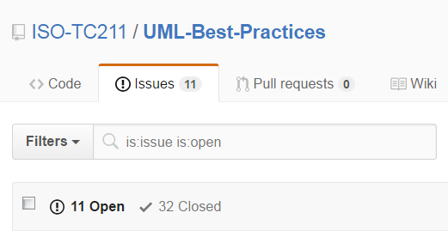
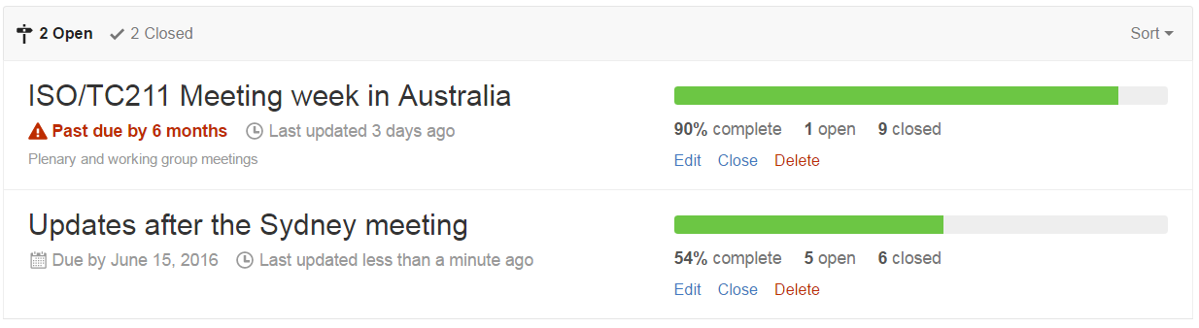
Progress report

Slide 5
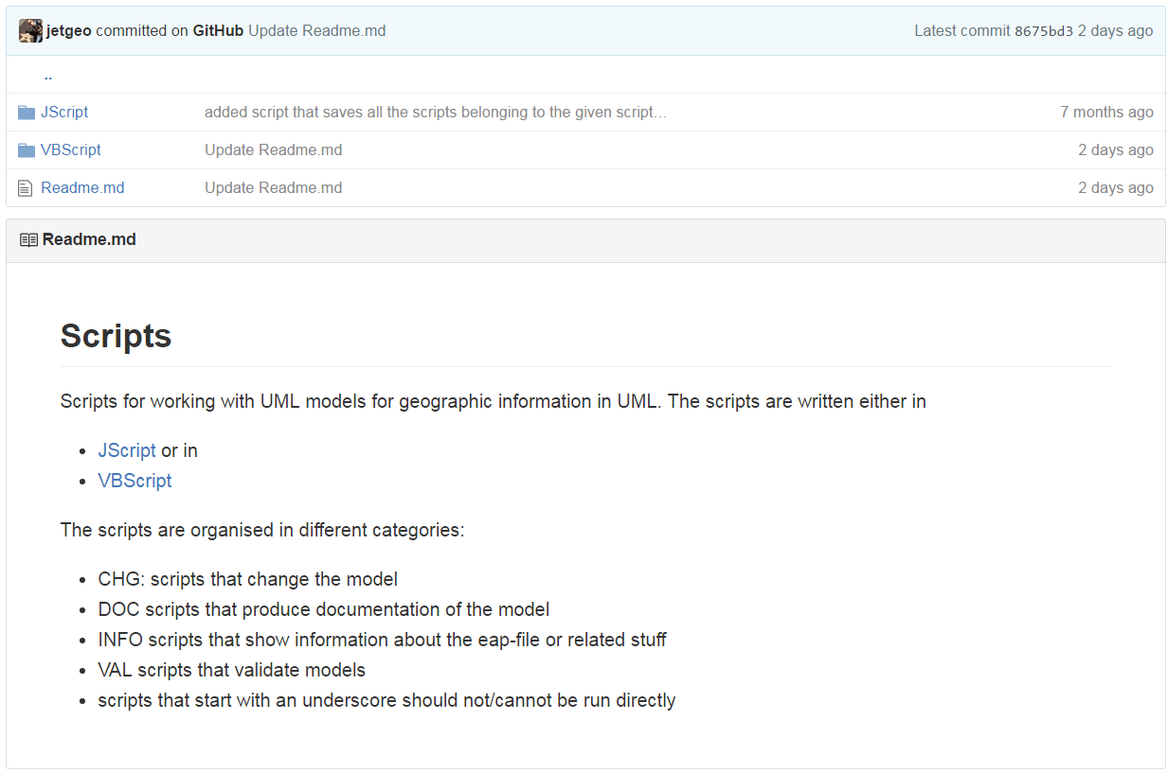
Scripts
https://github.com/ISO-TC211/UML-Best-Practices/tree/master/Scripts

Slide 6
Issues for discussion
Closed issues:
https://github.com/ISO-TC211/UML-Best-Practices/issues?q=is%3Aissue+is%3Aclosed+sort%3Aupdated-desc
Active issues:
https://github.com/ISO-TC211/UML-Best-Practices/issues

Slide 7
Discussion topics from projects or working group meetings
Input from GOM – experiences from the work on Ontologies.

Slide 8
Other issues to add

Slide 9

Revised action plan
Options:
Merge into HMMG
Create new permanent group, associated to HMMG
Continue as AHG
Wiki to be moved to official ISO/TC211 Wiki in the future

